Slide 1
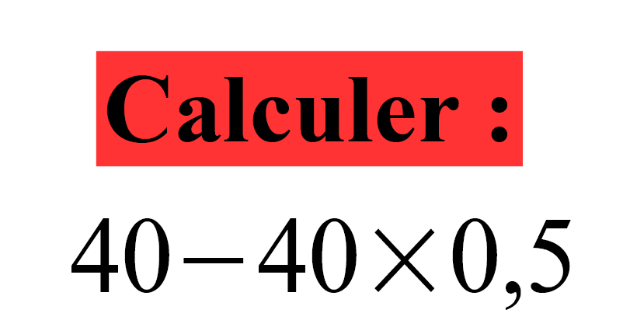

Slide 2
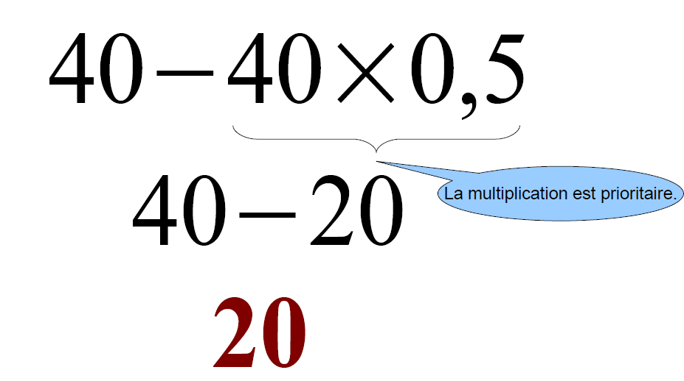
Correction

Slide 3
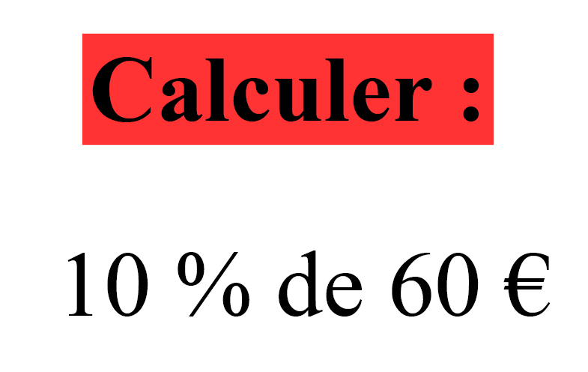

Slide 4
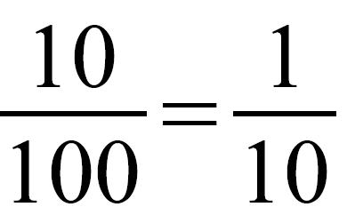
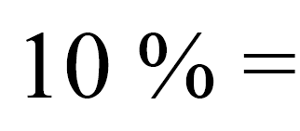
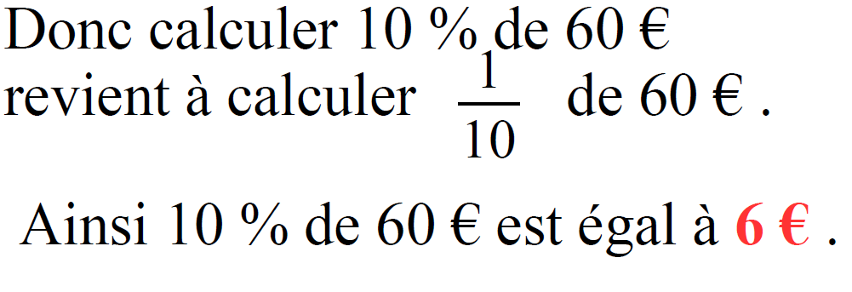
Correction

Slide 5
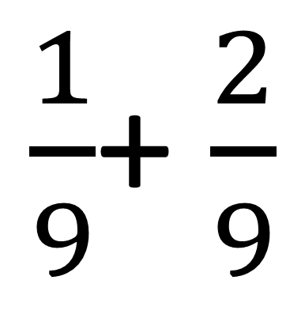
Calculer :
$\frac{1}{9}$+ $\frac{2}{9}$

Slide 6
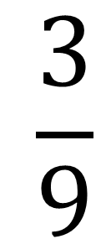
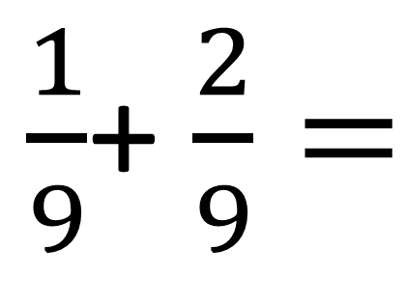
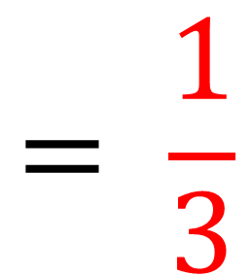
Correction
$$\frac{3}{9}$$
$\frac{1}{9}$+ $\frac{2}{9}=$
$$= \frac{1}{3}$$

Slide 7
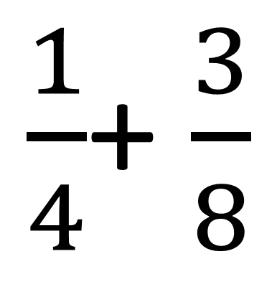
Calculer :
$\frac{1}{4}$+ $\frac{3}{8}$

Slide 8
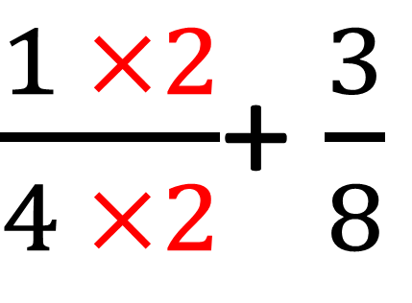
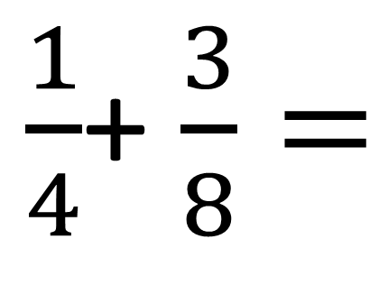
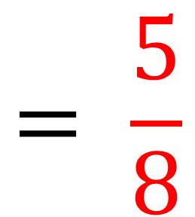
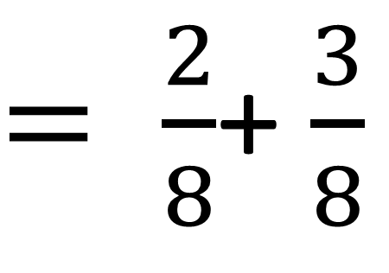
Correction
$\frac{1}{4}$+ $\frac{3}{8}=$
$\frac{1 ×2}{4 ×2}$+ $\frac{3}{8}$
$= \frac{2}{8}$+ $\frac{3}{8}$
$$= \frac{5}{8}$$

Slide 9
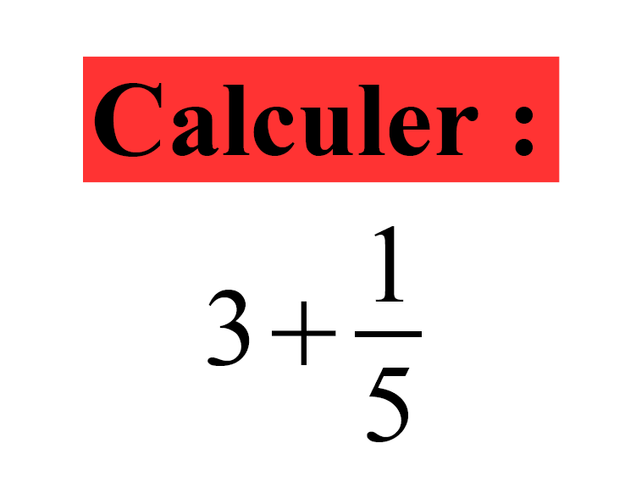

Slide 10
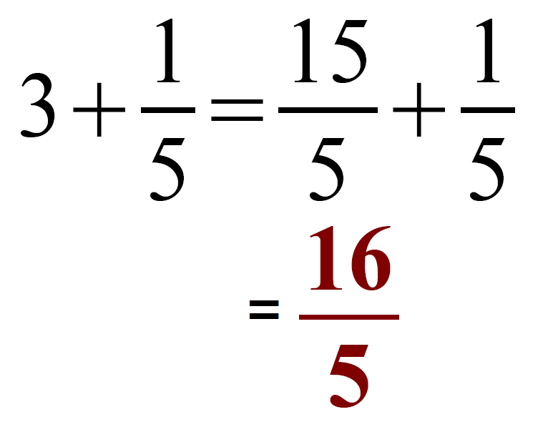
Correction

