Slide 1
Calculer :
- 15 + 5

Slide 2
Correction
- 15 + 5 = - 10

Slide 3
Calculer :
6 - ( - 5)

Slide 4
Correction
6 - (- 5) = 6 + 5
= 11

Slide 5
Calculer :
- 10 - 11

Slide 6
Correction
- 10 - 11 = - 10 + (- 11)
= - 21

Slide 7
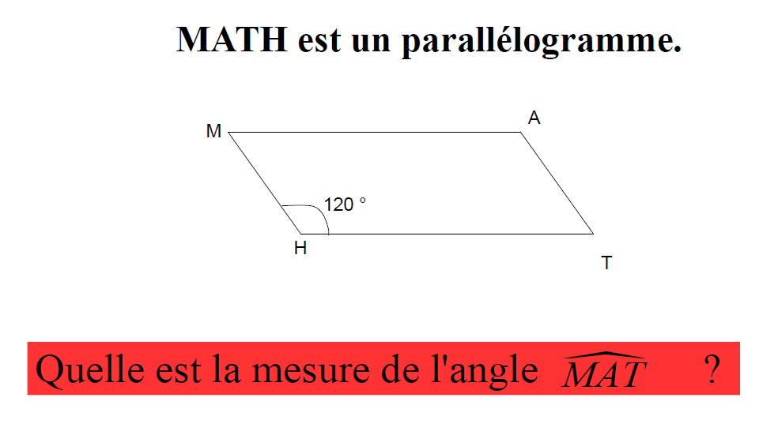

Slide 8
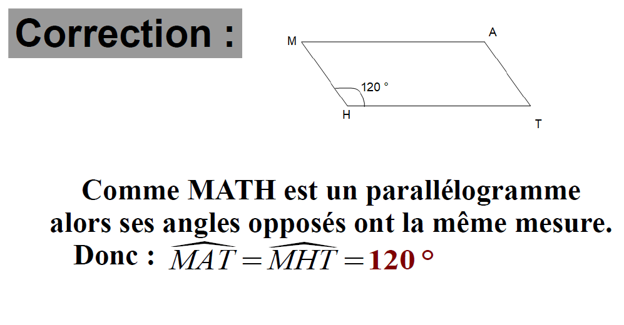

Slide 9
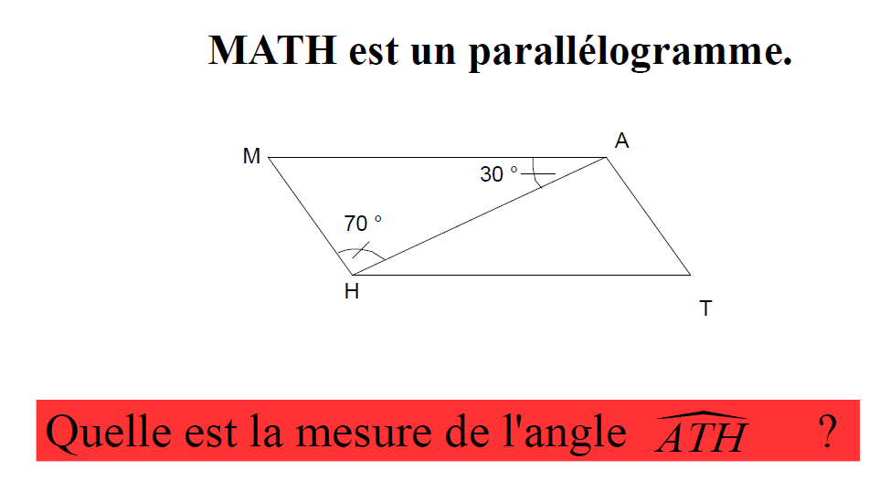

Slide 10
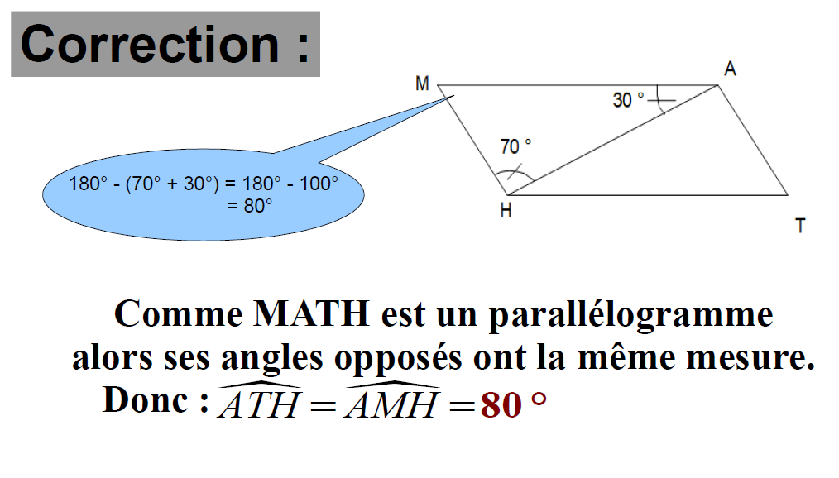

Slide 11
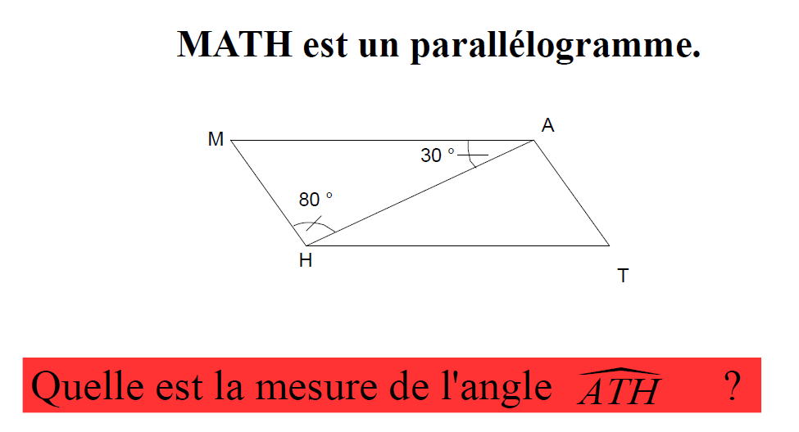

Slide 12
